Slide 1
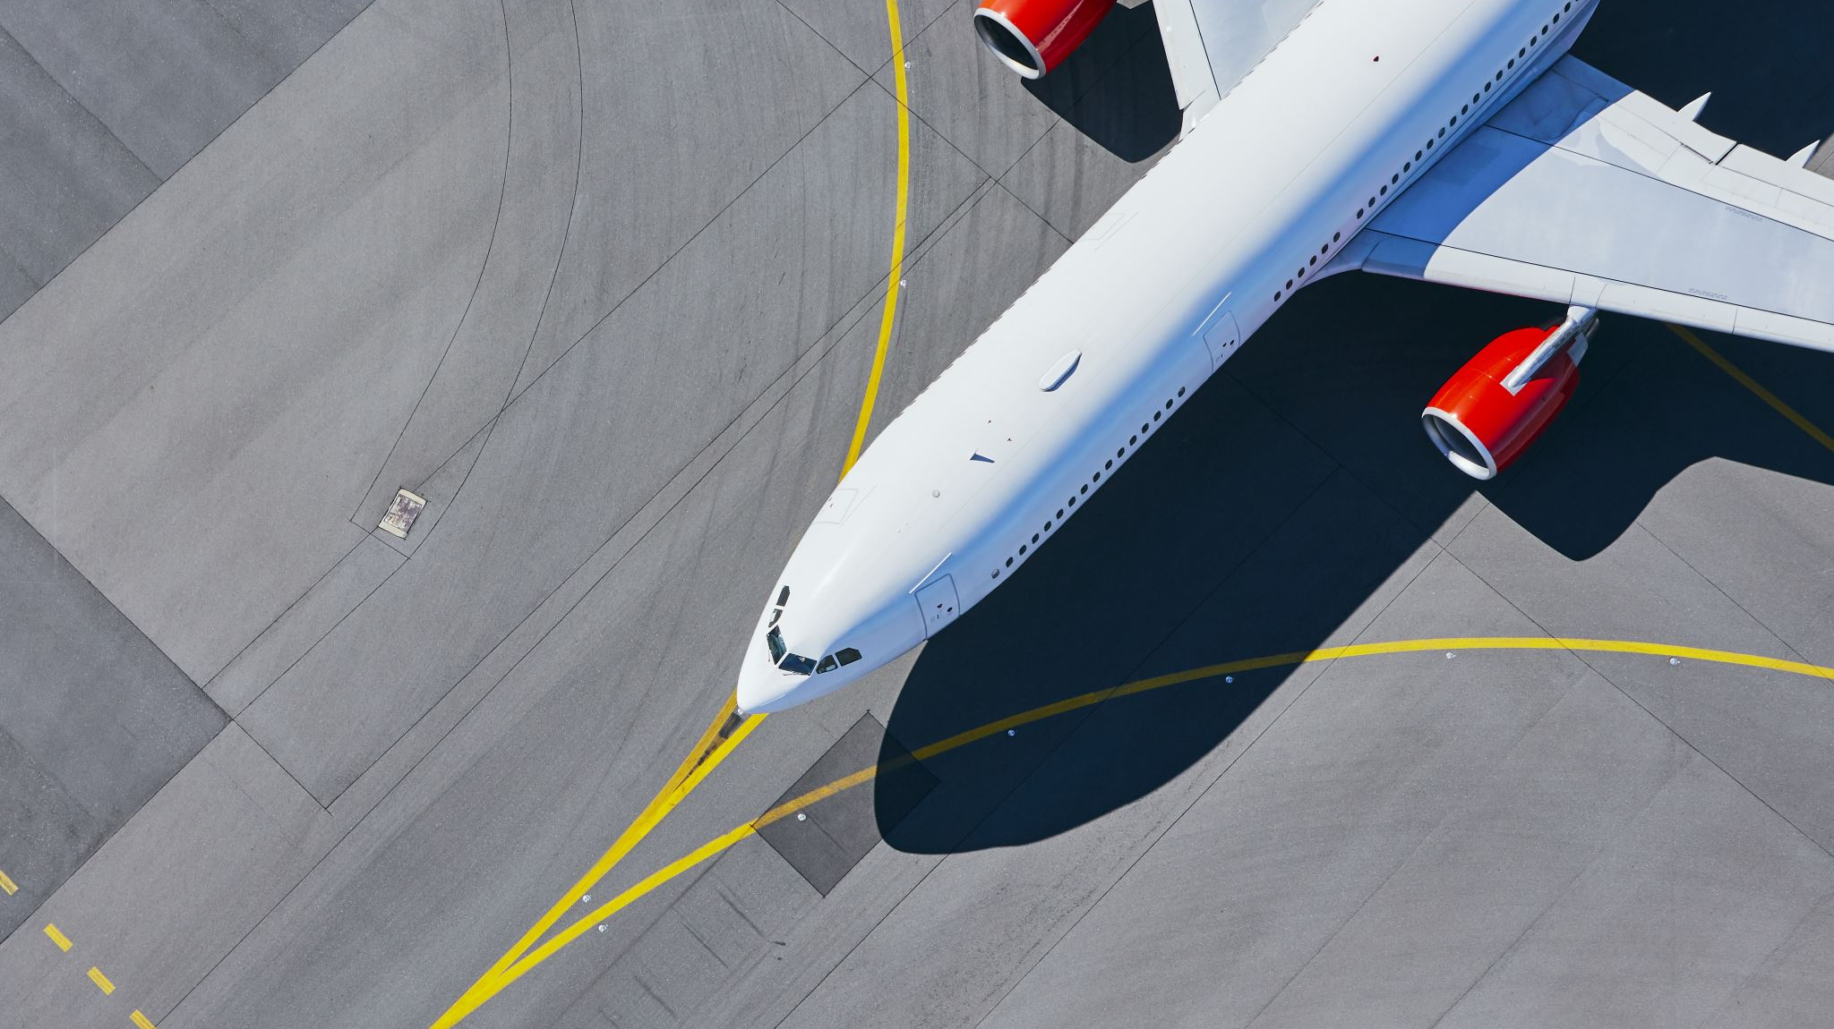

Changes in Air Traffic Patterns during Covid-19 And After
Group 6
Ava Lee
Christophe Guenther
Jed Murphy
Silas Phillips
GITHUB URL-https://github.com/silas-ph/Group_6_EDA

Slide 2
Challenges and Problem
Storage issues with GitHub
Large datasets created storage issues both locally
Airfare data was only available by quarter not by month

Slide 3
Goals and questions
**We are only making inferences based on our data**
How did air passenger traffic change?
When did passenger volume normalize?
How did the airfare change?
What are the changes before and after Covid-19?

Slide 4
EDA Methods and Techniques used for this report
Download and import files
Run basic EDA glob, for loops, check & correct NA, drop duplicates
Merge & combine the files into different DataFrames for analysis
Consistency checks
Combine data into summary DataFrame
Data exploration

Slide 5

Results of our analysis

Slide 6
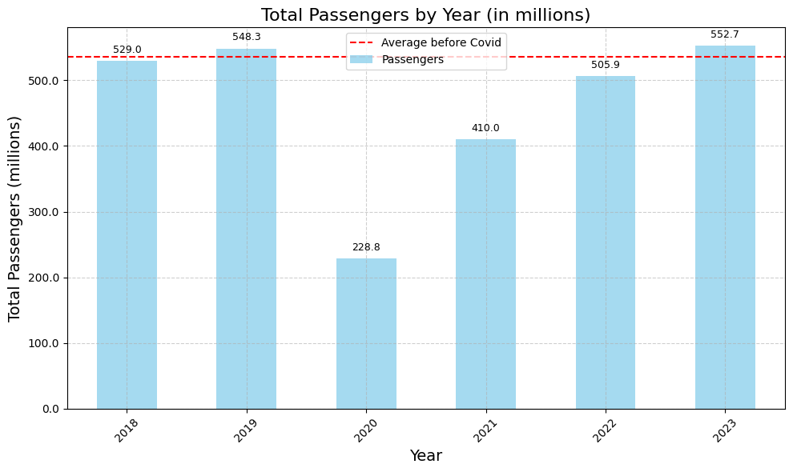
Question 1: How did U.S. air passenger traffic change?
Notes:
The total passenger traffic dropped 319.5 million
In 2019 from the previous year.

Slide 7
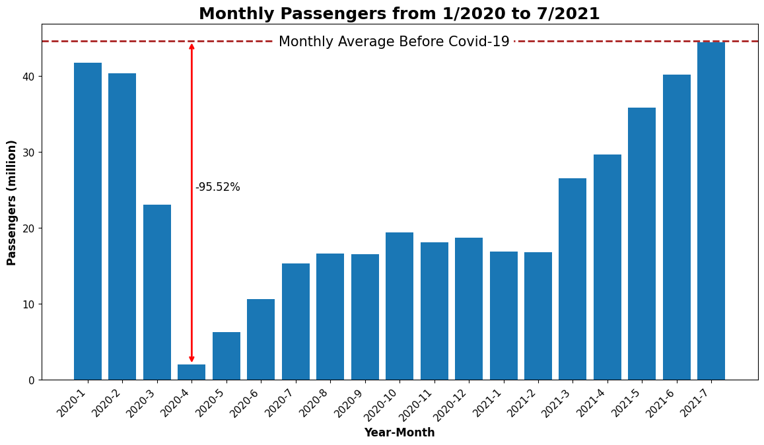

Question 1: Continued
Notes:
Total number of passengers flying dropped from 41.75 million in January 2020 to 2.0 million in April 2020 – a staggering 95.2% decline in just three months.

Slide 8
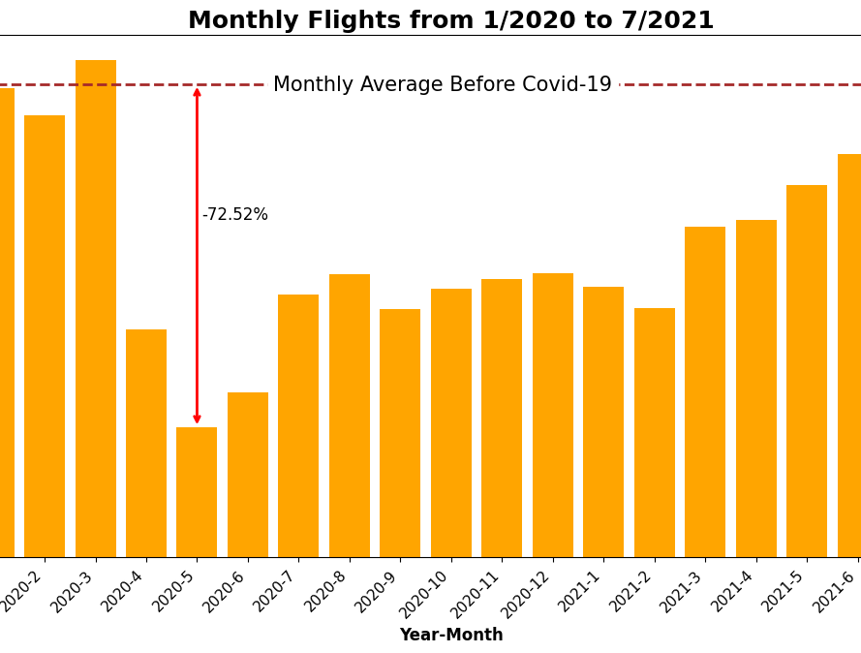
Monthly passengers
Notes:
The number of flights dropped by 75.52% as compared to its average before Covid

Slide 9
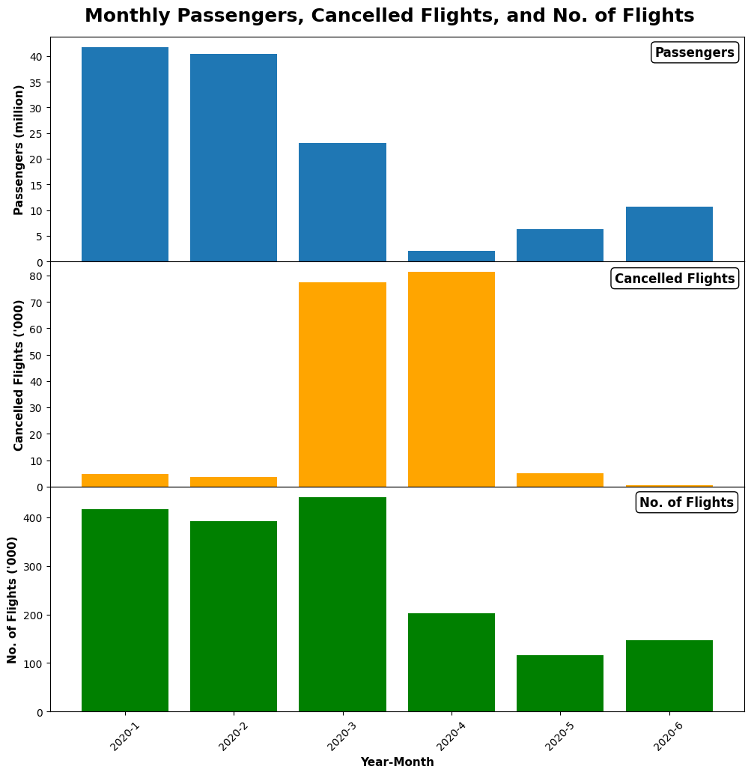
Air industry response
Cancellation rate for U.S. domestic flights reached 41.57% in April 2020, compared to just 2.31% in April 2019.
???????
As the number of flights declined, the cancellation rate gradually decreased. In December 2020, the domestic flight cancellation rate was 1.24%, commensurate with the 1.01% cancellation rate recorded in December 2019.

Slide 10
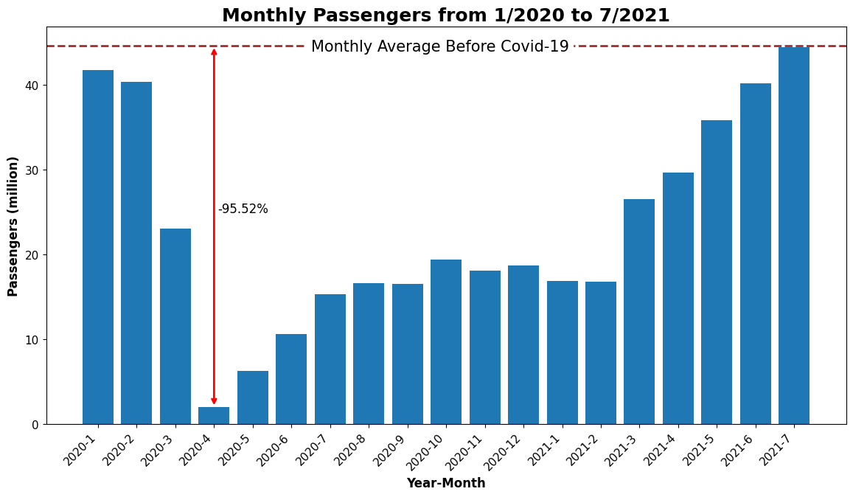
Question 2: when did passenger volume normalize?
Notes:
By July 2021 passenger volume had normalized the Pre-pandemic average

Slide 11
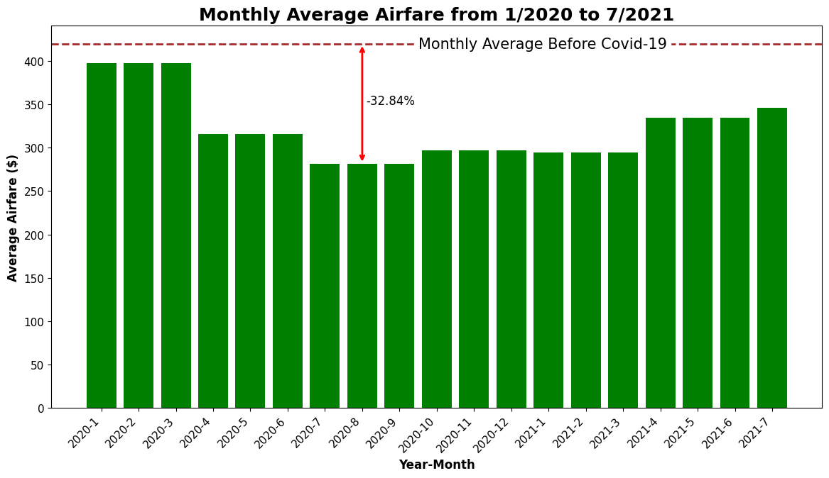
Question 3: How did the airfare change?
**Airfares by quarter adjusted for inflation**
Notes:
(inflation adjusted to quarter 3 of 2023) during the Covid-19 period. Average air faire declined by 32.84% as compared to its average before Covid-19.

Slide 12
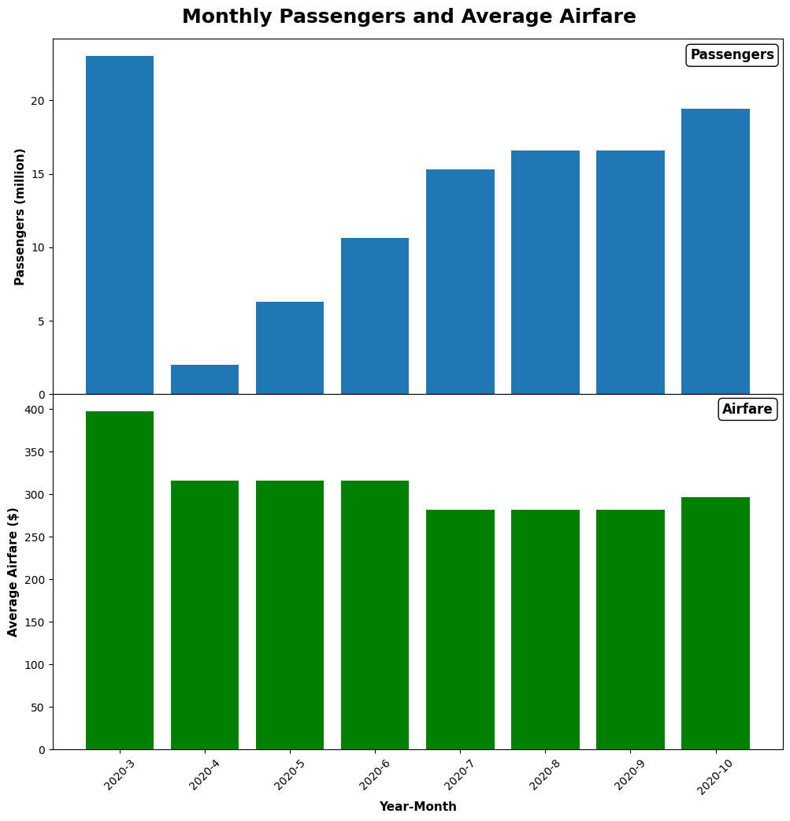

airfare reached minimum three months after passenger volume.
observation

Slide 13
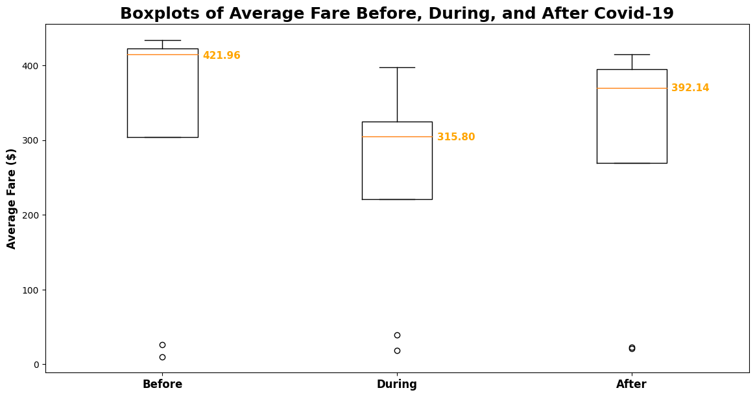
Question 4: changes before and after Covid-19?
Change of airfare
Before – During: 25% , Before – After: 7%

Slide 14
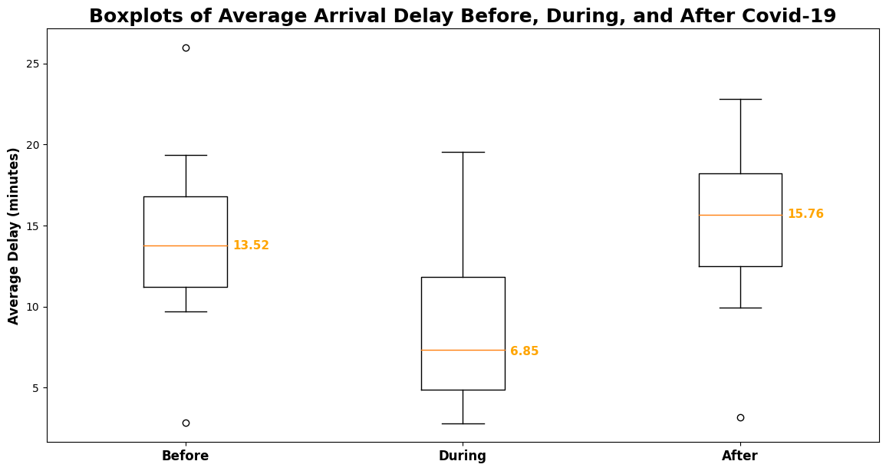
Question 4: changes before and after Covid-19?
Change of arrival delays
Before – During: 49% , Before – After: 16.5%

Slide 15
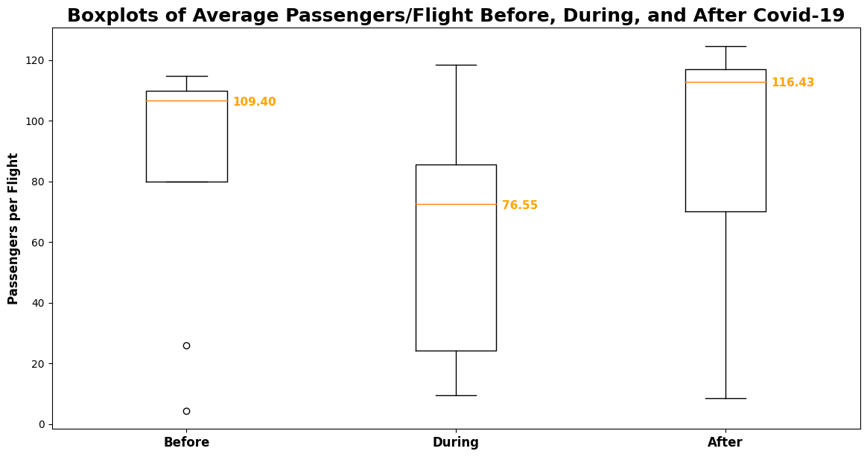
Question 4: changes before and after Covid-19?
Change of passengers per flight
Before – During: 30% ,
Before – After: 6%

Slide 16
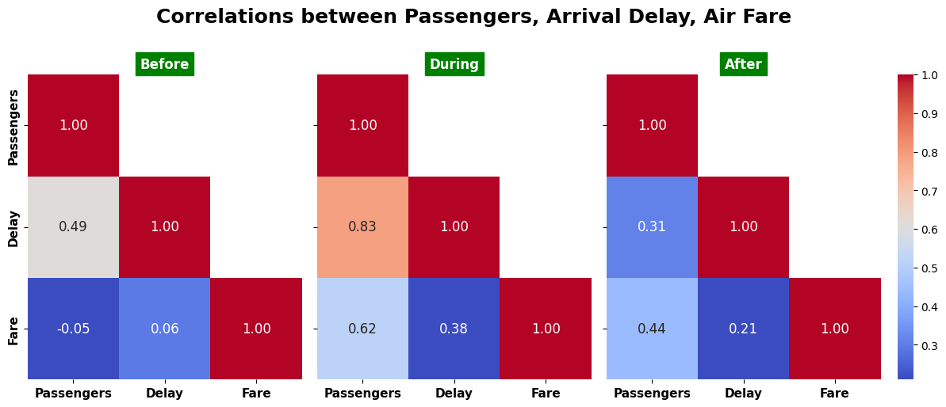
Other results
Notes:
Comparing the correlations between passenger volume, airfare, and arrival delays for the periods before Covid-19, during Covid-19, and after Covid-19, see the following plot.
Note, however, that this moderately strong positive correlation has persisted after Covid-19, although it is less strong. Further investigation is needed to understand this observation.
A further observation is that the positive correlation between passenger volume and delay increased considerably during Covid-19, although the size of the average delay decreased considerably.

Slide 17

Conclusion
Key Points:
Passenger volume decreased by 95.5%, number of flights decreased by 75.5% , airfare decreased by 32.8%
**Cancelled flights increased significantly in the first months of Covid-19.
Airfares reached their minimum about three months after passenger volume reached its lowest point.
The decline in airfares was less severe than the decline in passenger volume or the number of flights.
Airfare is still lower, arrival delays are higher, number of passengers per flight is higher, and correlation between passenger volume and airfare still moderately strong.

Slide 18
Recovering from the pandemic
Post Pandemic
Passenger volume had recovered to its average before Covid-19 by July of 2021. However, other metrics, notably the number of flights and the airfare, were still depressed as compared to their pre-pandemic averages. In fact, the median airfare has still not reached the same level it had before Covid-19.
Average arrival delays after the pandemic has increased compared to before Covid-19
The median airfare is still lower, arrival delays are higher, the number of passengers is higher, and the correlation between passenger volume and airfare is still very similar to that during Covid-19.

Slide 19

Topics for further investigation
What explains the difference in decline between passenger volumes, number of flights, and average airfare?
What is the exact month when the airfare reached its minimum?

Slide 20
SOURCES
The data used for the report falls under the Freedom of Information act. United States. Department of Transportation. (2022). Managing Rights. https://doi.org/10.21949/1520564
Flight Data
Passenger Data
Airfare Data
Dataset Title: Marketing Carrier On-Time Performance (Beginning January 2018) U.S. Department of Transportation, Department of Transportation Statistics URL: https://www.transtats.bts.gov/DL_SelectFields.aspx?gnoyr_VQ=FGK&QO_fu146_anzr=b0-gvzr Dates Accessed: 4/8/2024 - 4/17/2024. Other Details: Data retrieved from January 2024 to December 2023 as monthly ‘.csv’ files.
Dataset Title: Passengers All Carriers – All Airports U.S. Department of Transportation, Department of Transportation Statistics URL: https://www.transtats.bts.gov/Data_Elements.aspx?Data=2
Dates Accessed: 4/8/2024 - 4/17/2024. Other Details: Select “U.S. Carriers” and each major airport from the dropdowns and retrieve a ‘.csv’ file for every major airport. Data from October 2002 through December of 2023.
Dataset Title: Average Domestic Airline Intineray Fares U.S. Department of Transportation, Department of Transportation Statistics URL: https://www.transtats.bts.gov/AverageFare/
Dates Accessed: 4/10/2024 - 4/13/2024 – 4-18-2024 Other Details: Average airfare is by quarter.

Slide 21
ADDITIONAL RESOURCES USED
Using Python glob function
Visualizations
https://www.geeksforgeeks.org/how-to-use-glob-function-to-find-files-recursively-in-python/
https://matplotlib.org/stable/gallery/lines_bars_and_markers/barchart.html#sphx-glr-gallery-lines-bars-and-markers-barchart-py
https://matplotlib.org/stable/api/axes_api.html#module-matplotlib.axes
To fix correlation matrix: Seaborn heat map doesn't display annotations for all rows #14363, https://github.com/microsoft/vscode-jupyter/issues/14363, accessed on 4/17/2024
https://matplotlib.org/stable/gallery/lines_bars_and_markers/barchart.html#sphx-glr-gallery-lines-bars-and-markers-barchart-py
https://matplotlib.org/stable/api/axes_api.html#module-matplotlib.axes
https://medium.com/
Stackoverflow.com
www.python.org
Replicate columns
https://www.statology.org/pandas-replicate-rows/

Slide 22
Questions and awswers

